Slide 1
URBN Classification Guideline
Global Trade and Compliance Department
October 2018

Slide 2
Classification
Classification is the process of defining your product as a numerical code using the Harmonized System (HS)
Every item that is transported internationally has a HS tariff classification number

Slide 3
Classification
The first 6 digits are harmonized worldwide
Additional digits are unique to a country (8 digits, 10 digits)
Countries use the harmonized system to assess and apply import duties
Each country has their own schedule
Ex: Integrated Tariff of the European Communities (TARIC)
Harmonized Tariff Schedule of the United States (USHTS)

Slide 4
Harmonized System
Organized by chapters; total of 99 chapters
Chapter 1: Live animals
Chapter 39: Plastics and articles thereof
Chapter 61: Articles of apparel – knitted
Chapter 62: Articles of apparel – woven
Chapter 64: Footwear, gaiters and the like
Chapter 70: Glass and glassware
Chapter 94: Furniture, lamps/lighting

Slide 5
How to Read the Harmonized Tariff Code
Example: 6110.20.9900
6110.20.9900 – First 2 digits = CHAPTER
6110.20.9900 -- 4 digits = HEADING
6110.20.9900 -- 6 digits = SUBHEADING

Slide 6
How to Read the Harmonized Tariff Code
6110.20.9900
Code Definition
61 Chapter: Articles of Apparel, Knitted or Crocheted
6110 Heading: Jerseys, pullovers, cardigans, waistcoats and similar articles of knitted or crocheted
6110.20 Subheading: Of cotton
Specific to the TARIC
6110.20.9 Other
6110.20.9900 Other Sweaters Women's

Slide 7
How do you determine what chapter your product belongs in?
UNDERSTAND the product
1. What is it ?
2. What is it made of? (composition)
3. What does it do?
4. What is the end use, or how is it used?
What is the “essential character” that best describes the product

Slide 8
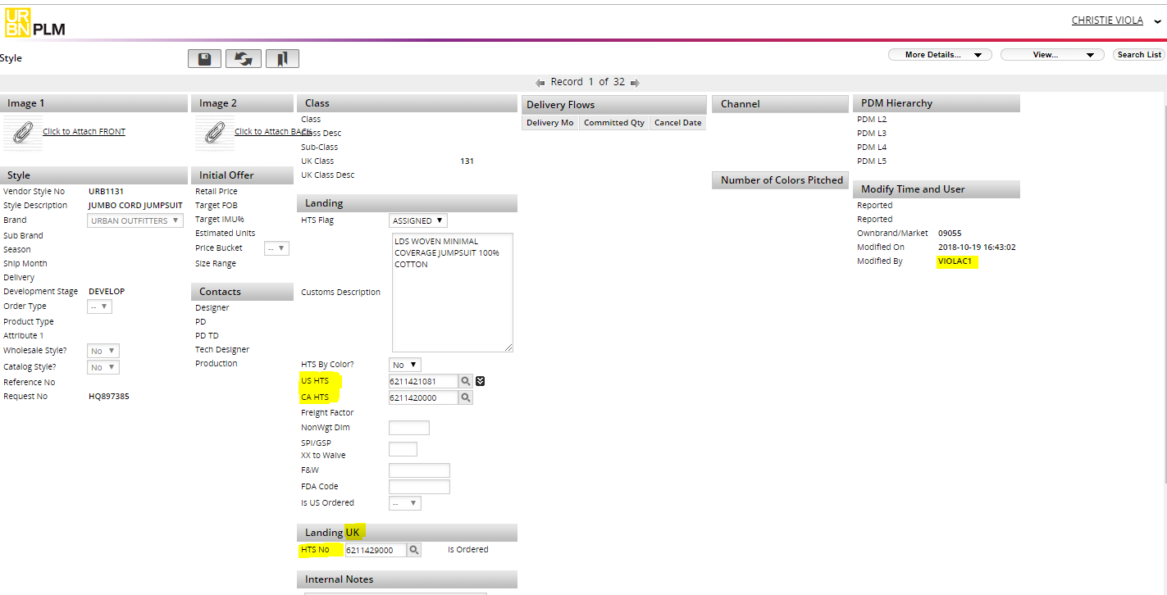
Assigning HTS & Comm Codes
The US Global Trade & Compliance team will add the HTS & Comm Code in Tradestone by the Style level.

Slide 9
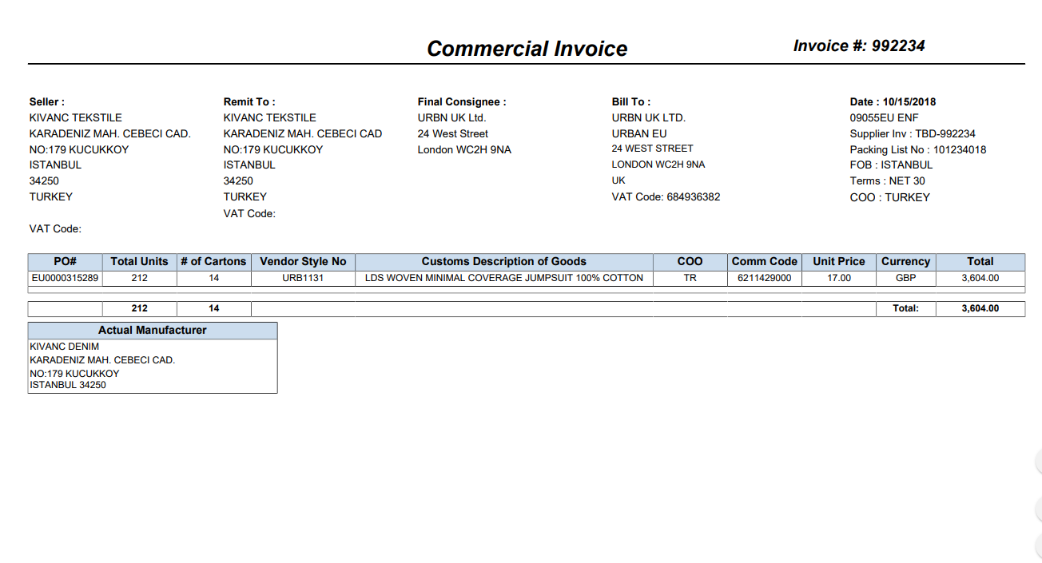
Vendor Should Submit The TS CI to Freight Forwarder

