Slide 1



Inbound Transportation
Playbook

Slide 2

The purpose of the Inbound Transportation Playbook is to serve as a tool for the Organization to promote knowledge sharing, empower decision-making, and drive Supply Chain Value.
Version # | Date Updated | Created/Updated By
Version 1 | 12/10/2018 | E. Schwartz
Version 2 | 1/9/2019 | E. Schwartz
Version 3 | 3/14/2019 | A. Fasanella
Version 4 | 7/1/2019 | A. Fasanella

Slide 3





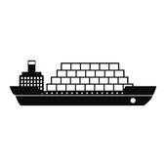






Table of Contents
  Inbound Transportation Team.…………………………………………….
4
  Inbound Transportation Merchandise Flow……..………………….
5
  Air Inbound Transportation Network…………………………………..
6
  Ocean Inbound Transportation Network……………………………
7
  PO Tracking & TradeStone Comments……………………..............
10
  Inbound Transportation – Air……………………………………….……..
15
  Inbound Transportation – Ocean………………………..............…..
17
  Transportation Cost Synopsis……………………………………….……..
18
  Incoterms Breakdown……………………………………………….………..
19
  Buyer’s Checklist……………………………………………………….………..
20
  Frequently Asked Questions………………………………….…………….
21
  Additional Resources……………………………………………………….….
22
  Inbound Transportation Glossary………………………………….…….
23

Slide 4






Inbound transportation Team
 | Elton Poisler Director, Global Logistics | Email: epoisler@urbn.com Phone: x5678
 | Lasheka Mitchell Sr. Import Transportation Specialist Category Management, Ocean | Email: lmitchell@urbn.com Phone: x4817 Responsibilities: Manages Ocean Bookings & Ocean Transportation from the FOB origin port to the port of arrival in the US.
 | Eric Carr Inbound Transportation Operations Manager | Email: ecarr@urbn.com Phone: x3726 Responsibilities: Manages Operational improvements and the development of new value add within the overall Import Operation.
 | Emily Schwartz Sr. Inbound Transportation Analyst | Email: eschwartz@urbn.com Phone: x7853 Responsibilities: Supports the Inbound Transportation Team by aiding in data and analysis requests.
 | Andy Fasanella Inbound Transportation Specialist Category Management, Air | Email: afasanella@urbn.com Phone: x4803 Responsibilities: Manages the Air Inbound Transportation operation.
 | Jonathan Quinet Inbound Coordinator | Email: jquinet@urbn.com Phone: x4892 Responsibilities: Manages all container movements from US port to the arrival at the DC, PT Transload, and Transportation of prepaid US Domestic Vendors.

Slide 5
Inbound Transportation
Flow
Air and Ocean Merchandise Flow
Inbound Transportation Scope:
Procurement of Transportation Services and Operational Execution of all Inbound Merchandise
PO is Created
Vendors handover merchandise to Transportation Provider
Transportation takes ownership of the operations at this point
Freight Forwarder takes possession of freight
Freight Forwarder ensures and confirms that the merchandise is exported
Merchandise arrives at appropriate DC or FC
Merchandise is broken down and sorted appropriately
Merchandise is unloaded at the terminal
Prepared for delivery to the appropriate DC or FC
POs Arrive in US
Merchandise is thoroughly inspected and then cleared by Customs

Slide 6
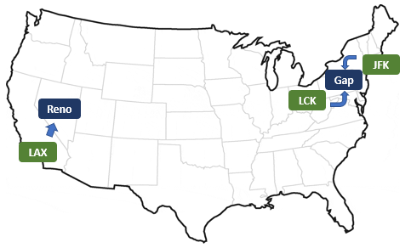
Air Inbound Transportation Network
Air Transportation Milestones
Merchandise from all global origins are flown into two main airports: JFK or LAX
All Inbound POs Consigned to Reno, NV enter the US via LAX.
Most Inbound POs consigned to Gap, PA enter the US via JFK.
Ownbrand POs consigned to Gap, PA that ship from Hong Kong and Shanghai will enter the US via Columbus, OH (LCK).
Air Transportation Common Challenges
Delays at one airport can have a global impact on the movement of merchandise
Demand exceeds Capacity
Sudden surges in volume
Large, volumetric shipments
Congestion at origin and/or JFK & LAX
Weather and other environmental delays
Labor/Political Unrest
Holidays cause airport delays and backlogs

Slide 7
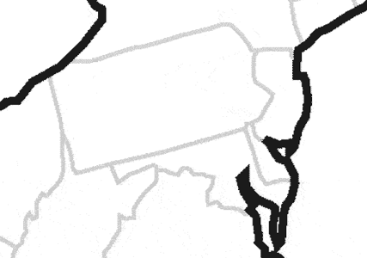
Ocean Inbound Into the East Coast
NY / NJ Ports
Furniture POs from all origins
IFC
Gilbert Transload
Gap
Ocean POs from Europe, Middle East, India, &
South America
To Reno
Non-Furniture
  All ocean POs that come from India, Europe, Turkey, Africa, South America and the Middle East are shipped to the Ports of New York/New Jersey
  Gilbert is responsible for the de-consolidation of merchandise at the LA Port.
  Merchandise is trucked to our Reno and Gap facilities.
Furniture
  All furtniture from all origin locations are shipped to the Ports of New York/New Jersey
  Containers are trucked directly to IFC

Slide 8
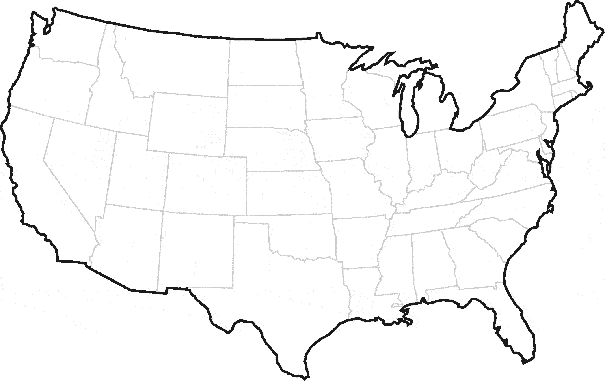
Ocean Inbound Into the West Coast
Ocean POs from China, SE Asia, & Oceania
Gap
Reno
LA Ports
PT Transload
West Coast Inbound Network:
  All POs (except furniture) from China, North Asia, Southeast Asia, Oceania are shipped to the LA Ports.
  Performance Team is responsible for the de-consolidation of merchandise at the LA Port.
  Merchandise is trucked to our Reno and Gap facilities.

Slide 9
Performance Team Transload (PT)
Ocean Inbound Into the West Coast (Ports of Los Angeles)
What is Transload?
  Transload is a process that changes a shipment’s ship mode to another ship mode.
What is PT?
  Service provider that manages URBN’s transload operation.
    Pickup of ocean containers from the LA ports.
    Unload the containers at their warehouse.
    Reload the freight into trucks exclusive to the DC Campuses.
What POs go through PT?
  All ocean POs that come from China or other Asian origin countries.
  POs from domestic collect vendors based in the greater Los Angeles region.
Why is Transload Necessary?
  The LA ports are too far away from Reno and Gap.
  PT loads trailers exclusive to the Gap and Reno campuses.
  Reduces the number of trucks required to deliver to the DCs.
Performance Team Transload Report
  What is it?
    Daily excel report that provides detailed status updates of POs that are scheduled, currently located or have already gone through PT.
  What is the purpose of this report?
    The report providers detailed information of a given PO’s status and current location. This provides additional visibility over TradeStone.

Slide 11
Inbound Transportation - Guidance
How to track & trace a PO…
Go to TradeStone Dashboard
Use “NEW-Import PO List” or “Ship Status -New” query
Comments will only appear if:
POs shipped via FedEx courier:
To identify FedEx courier POs in TradeStone:
  Verify booking date in Tradestone
  Was this booked?
  If Yes?
  If No?
  Was this handed over to the forwarder?
  If TradeStone is blank, contact vendor.
  See FAQ section
  Reach out to IT if you do not have access to these queries.
  Transportation status comments with ETAs to the DC / Performance Team will also appear in these queries.
  The shipment is in transit.
  The “Container/ HAWB” field is populated with data.
  Note: only air, ocean & trucks from PT Transload will have comments.
  Will not have comments in TradeStone
  Look for “FEDERAL EXPRESS” as the forwarder
  In the “ctnr /HAWB” column, if the populated data is a 12-digit number (no letters), that is a FedEx tracking # and can be looked up on fedex.com
Transit Matrix
S:\Import Transportation Information\TRANSIT MATRIX
NOTE: For inquiries in regards to the Ocean Guaranteed Service, please contact Transportation

Slide 12





Important Milestones in TradeStone
Date the vendor completes booking with freight forwarder.
*Check with the vendor if the required booking date has past and data field is blank.
Date the vendor turns over the PO to the freight forwarder at the origin FOB port.
*Check with the vendor if the required ship date has past and data field is blank.
“Planned ETD” is the estimated date of departure from the origin FOB port.
“Export Date” is the actual date of departure from the origin FOB port.
“ETA POE” is the estimated day of arrival at the US port or airport.
“Actual POE” is the actual day of arrival at the US port or airport.
“Actual at Yard” is the date the PO arrives at the destination location. Transportation’s role ends here and DC functions begin.
“BOL Deliver To” is the shipment’s destination location.
“Transportation Comments” provide additional information about the ETA to the DC. Notification of delays and exceptions are also captured here.
Comments are updated daily!
*Allow 24 hours for air milestone information to populate in TradeStone
*Allow three days for ocean booking, cargo receipt, export date and ETA POE information to populate in TradeStone.
Allow 24 hours for ocean milestone information from the Actual POE and later to populate in TradeStone.
TradeStone Queries to Use:
NEW - Import PO List
NEW-Ship Status Trans

Slide 13
Transportation Comments - AIR
ETA TO DC BY MAR 8 – PO is currently on track to arrive at the DC Yard on or before the specified date (March 8 in this example).
CHARTER – ETA TO DC MAR 8 – Projected ETA to the DC Yard for POs that shipped via the Hong Kong and Shanghai Charter service.
SCHED TO DEL TO DC 3/8 – Forwarder has confirmed the PO will deliver to the DC Yard on the specified date.
DEL TO DC 3/8 – PO delivered in full to the DC Yard on the specified date.
PARTIAL BAL DEL TO DC 3/8 – The shipment delivered to the DC incomplete on the specified date. This comment is at the shipment level, please check with logistics for status of your PO.
FULL BAL DEL TO DC 3/8 – Shipment initially delivered to the DC incomplete. The missing balance subsequently delivered on the specified date to complete the shipment.
F&W – Shipment will require release from U.S. Fish & Wildlife. Transportation is unable to provide an ETA to the DC until release is received.
FDA – Shipment will require release from the U.S. Food and Drug Administration. Transportation is unable to provide an ETA to the DC until release is received.
PENDING RELEASE – Timing of the shipment’s release is longer than normal and may cause delays to the DC. Transportation is unable to provide an ETA to the DC until release is received.

Slide 14
Transportation Comments - OCEAN
AT PORT – Import container has confirmation of delivery to US port.
CUSTOMS HOLD – Import container is currently held at port and not available due to customs related review.
FREIGHT HOLD – Import container is currently held at port and not available due to carrier related review.
CONTAINER ETA GFC MM/DD – ETA the ocean container will arrive at the mentioned DC’s Yard. This did not go through East or West Coast Transload. Please check with the DC for the cross dock status of POs that are not consigned to the DC mentioned in the comment.
ETA TRANSLOAD MM/DD – Import container has been scheduled to deliver to transload facility from port.
AT TRANSLOAD MM/DD, SEE TRUCK – Import container has arrived at transload site and related purchase orders will be available in TradeStone within SLA under a new domestic trailer. The PO will have or soon have a new line in TradeStone that represents the final truck to the consigned DC. The comments here will be to the actual URBN DC. This information can also be found in the PT Transload report.
ETA DC MM/DD – Scheduled final delivery date of domestic trailer to URBN site. DC will contain the URBN site to which the container is delivering to (GAP, GFC, REN, RNO, RSA, MNC, MNCA, MLA). If date in comment in field is in past, the ‘At Yard’ data field will confirm final delivery.
SLSN ETA GFC 3/9 GAP 3/9 RNO 3/12 – Pertains to ocean POs that go through east coast transload. Unlike PT, POs that depart from East Coast transload are unable to send trucking information to TradeStone. This comment represents all the POs that were on the former ocean container., which includes ETA Gap, GFC and the Reno Campus. The Reno Campus will almost always be a combined trailer. Please reference the ETA of your PO’s consigned DC.

Slide 15
Inbound Transportation - Air
Standard Air vs. Express Air Approval
Authorized Brand/Production representative must approve a PO to ship via Express Air & notify Transportation via email
Consult the Transit Matrix for lane by lane specifics on timing.
Standard Air
Express Air
The default service for air
Rates in TradeStone and the Transit Matrix are calculated from the Standard Air service level
Transit Time: 2-3 days less than Standard
Advantages: direct flights, priority loading and/or carriage on a premium airline.
At least 20% more expensive than Standard Air
TradeStone does not capture express air rates
Charter
Air Service that can be utilized by pre-approved Ownbrand vendors from Shanghai and Hong Kong
Fast and dedicated Air service to Gap and Reno
Market vendors and non-approved Ownbrand vendors cannot ship on the charter and must use the Standard Air Service
Please Consult Transportation and Sourcing for questions regarding vendors that are approved for this service

Slide 16
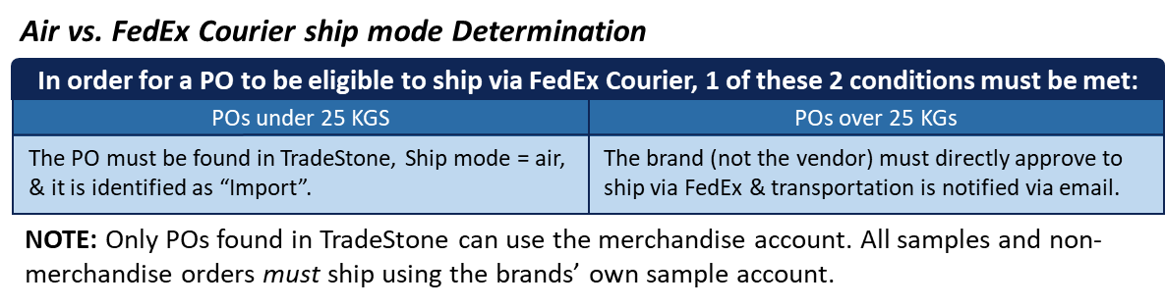
Inbound Transportation - Air
Instructions to ship via FedEx Courier
Eligible POs must follow the authorization process before the vendor is allowed ship using URBN’s FedEx merchandise account.
1
  The vendor must send an email to fedexauth@urbn.com with the TradeStone packing list and TradeStone commercial invoice included for each PO
2
  TradeStone documentation is then reviewed by the URBN Compliance team. If there is an issue, the vendor and/or the brand will receive instruction from URBN Compliance.
3
Following completion of Compliance review, URBN Transportation will send an authorization email to the vendor with approval to ship the requested PO(s) via FedEx courier.
4
Once the vendor receives the authorization email from URBN, the vendor will have all the approval they need and can now ship the PO.
5
Vendors are never allowed to ship a PO via FedEx without first receiving an authorization email from URBN.
NOTE: The vendor must follow all of the provided instructions in order for the tracking information to appear in TradeStone.
FEDEX RPI & LOA
Some origin locations require additional authorization to ship using FedEx courier.
If this is the case, complete a Letter of Authorization (LOA) and a Remote Pickup Inquiry Request (RPI) and have them signed by the FedEx account manager.
For sample shipments please contact your brand’s internal account holder
For Merchandise POs found in TradeStone please contact Andy Fasanella

Slide 17
Inbound Transportation – Ocean
KEY NOTES WHEN BOOKING:
The vendor must book 14 days prior handover
This is crucial to ensure that the PO ships by the appropriate ship date
Ocean
Within the Ocean ship mode, there are two different types of container loads:
Ocean Consolidated
Ocean Factory Loads
Freight for URBN all brands is consolidated and loaded into one container.
Vendor has freight forwarder consolidate.
One brand fills a full container
The full container is loaded by the factory and then handed over the freight forwarder.
Vendor loads
NOTE: Reefers are used to transport temperature controlled cargo
  These containers must be requested when making the booking
  Freight forwarder will need to know the required temperature for the Reefer
  Reefers come at an additional cost
Ocean Guaranteed / GVS
Alternative service to air, not to be used as a Standard service
When utilizing GVS, must receive approval from Transportation
A service that provides a guaranteed delivery date by the forwarder, not a guarantee of speed
The service promises an ETA date and not a set number of transit days
This service runs from the origin to the DC and is managed by the freight forwarder
This service comes at an additional cost
Less Than Container Load (LCL)
Any freight moving under 6 CBMs will move via LCL
In the Transit Matrix, there are no calculations around LCL because there are significant risk factors associated with LCL Freight once the freight arrives at the US Ports
  Risk factors include, but are not limited to: less visibility on when the freight will become available at the US Port, increased chance of being put on custom hold, experience freight delays, etc.

Slide 18
Transportation Costs
The below table highlights the extreme variance in price for each of the ship modes. It is absolutely crucial to understand the cost impacts of the different ship modes.
Please refer to the ELC Freight Calculator for more detailed shipment costs
  From a Transportation perspective the ELC calculator is a tool to calculate freight based on quantities and weights for the entire shipment by origin.
  Tradestone calculates the freight cost by PO at the style level. Tradestone incorporates a Freight factor into the freight rate. For questions on the freight factor please consult Production/Tradestone team
  Each calculation will have a different freight cost in the ELC.
  EXAMPLE FOR an AIR SHIPMENT FROM HANOI -> JFK:
ELC CALC TRADESTONE
OCN Cost/CBM – $0.10 OCN Cost/CBM - $0.29
AIR Cost/KG- $1.32 AIR- Cost/KG $1.32
DIFFERENCE - $1.01 Difference - $1.72
Sample PO Parameters:
Jakarta to Reno: 3000 units (0.5 KG/unit)
50 cartons 30 KG / Carton 6.25 CBM
1041.67 KG Dim Weight 1500 KG Gross Weight
Here is a cost breakdown of the cost impact of each ship mode for the Sample PO:
Ship Mode | Transit Time (days) | Freight Cost | Freight Cost per unit | Freight Cost per KG | Freight Cost per CBM
Ocean | 37 | $892.77 | $0.30 | $0.60 | $142.84
Ocean Guaranteed | X | X | X | X | X
Standard Air | 12 | $6,045.01 | $2.02 | $4.03 | $967.20
Express Air | 9 | $7,845.00 | $2.62 | $5.23 | $1,255.20
FedEx (URBN Accounts) | 3 | $17,836.50 | $5.95 | $11.89 | $2,853.84
NOTES: These calculations should only used as an EXAMPLE to highlight the extreme variance in price across the different ship modes. The exact costs and transit time will change on a case by case basis.

Slide 19
Incoterms
INTERNATIONAL COMMERCIAL TERMS
Incoterms define who is responsible for managing Transportation cost and designates the point where each party is liable for loss and damage.
Incoterms | EXW Ex Works | FOB Free on Board | DDP Delivered Duty Paid
Warehouse Services | Vendor | Vendor | Vendor
Export Packing | Vendor | Vendor | Vendor
Loading at point of origin | URBN | Vendor | Vendor
Origin Inland Freight | URBN | Vendor | Vendor
Origin Port Charges | URBN | Vendor | Vendor
Origin Forwarder Fees | URBN | Vendor | Vendor
Ocean/Air Freight | URBN | URBN | Vendor
Destination Port Charges | URBN | URBN | Vendor
Customs Clearance | URBN | URBN | Vendor
Import Duties & Taxes | URBN | URBN | Vendor
Delivery Cartage to Final Destination | URBN | URBN | Vendor
Free on Board (FOB): Current Standard process: URBN takes possession of the freight at the consolidation point. We have full visibility of the freight.
Delivered Duty Paid (DDP): The vendor is responsible for all costs to the URBN facility. There is no visibility when using this process.
Ex Works (EXW): URBN is responsible for arranging and paying for all costs from the vendor facility to the URBN DC/FC. We have full visibility of the freight. Used for very specific origins. Contact Transportation with any questions.

Slide 21
FAQ
Where’s my P.O.?
  See Page 5
What’s the transit time for a PO shipping via Air or Ocean?
  Check the Transit Matrix
Can a PO ship via FedEx courier?
  See Page 6
I don’t see the BOL information in TradeStone?
  See Page 7
Do I need a BOL?
  A Bill of Lading is required for all domestic shipments, Truckload or LTL.
  A Bill of Lading is not required for shipments shipped via UPS.
Where can I find the Freight Forwarder contact information?
  Vendor website
Did my vendor book?
  Check TradeStone, note that it may take up to 24 hours to appear in TradeStone
  If you still are unsure, contact the Vendor
Did my vendor hand over?
  Check TradeStone, may take up to 24 hours to appear in TradeStone
  Ask vendor for Forwarder Cargo Receipt (FCR)
How do I handle ship/cancel dates around Gold Week/Chinese New Year/Other Global Holidays?
  Transportation will provide a calendar with the last booking date, last handover date and Vessel ETA to Port for each origin
  Expect the calendar approximately 1-2 months prior to the Holiday (once the schedules are received from carriers)
  Please use the calendar provided to write POs during these and other National and Global Holidays

Slide 22
Resources
Transit Matrix: S:\Import Transportation Information\TRANSIT MATRIX | Booking Times: Ocean – 14 days before ship date Air – 2 Days approved, 5 days recommended before ship date Truck – 3 days before ship date
The International Routing Guide: http://www.urbnvendor.com/us/how-do-i-ship-internationally/ | Inbound Tracking Information: West Coast Import Transload Report (E-mail from Steven Scripko 11AM daily) Inbound PO Tracking in TradeStone: “NEW-Ship Status Trans” or “NEW - Import PO List” queries Domestic PO Tracking in TradeStone: “NEW - Domestic PO List”
The Domestic Routing Guide: http://www.urbnvendor.com/us/
URBN RPI Temple URBN RPI Template.pdf | URBN LOA Sample Template URBN LOA Sample Template.docx
ELC Freight Calculator ELC Freight Calculator | URBN Incoterms URBN Incoterms.jpg
TradeStone User Manual User Manual | Current LCL Origins List of LCL Origins
– If you have any further questions, please contact Transportation –

Slide 23
Inbound transportation Glossary
Term | Acronym | Definition
APL Logistics | APPL | A freight forwarder responsible for booking and consolidating ocean freight (APPL)
At Yard | -- | Date a specific shipment delivers to URBN site or transload facility
Actual Time of Arrival | ATA | Actual time of arrival at the destination port
Actual Time of Departure | ATD | Actual time of departure from origin port
Bill of Landing | BL / BOL | Bill of Lading, may also be referred to as ‘BL’
Cubic Meters | CBM | The volumetric term primarily used when referencing ocean shipments
Container Freight Station | CFS | The area where freight is consolidated or deconsolidated
Chargeable Weight | -- | The rating metric for air freight, the higher of ‘actual’ or ‘volumetric’ weight
Charter | -- | A specially arranged flight for limited customer use
Chassis | -- | Structure an ocean container is set on in order to dray over the road
Commercial Invoice | CI | A legal document between the supplier and URBN that clearly describes the sold goods, and the dollar amount due from URBN
Consolidation | -- | The process of collecting several orders to ship together on one or more shipments
Cross Dock | X Dock | The process of unloading one shipment and immediately loading on another shipment
Distribution Center | DC | A warehouse which is stocked with products to be redistributed to retailers, wholesalers, or directly to consumers.
DC2DC | -- | URBN term for the line haul truck moves between Gap, PA and Reno, NV
Dray | -- | The service performed to drive ocean containers out of a port to a specific location, also called ‘Drayage’
Estimated Landing Cost | ELC | Estimated landed cost
Estimated Time of Arrival | ETA | Estimated time of arrival
Estimated Time of Departure | ETD | Estimated time of departure
Ex. Works | EXW | This term places the maximum obligation on the buyer and minimum obligations on the seller.

Slide 24
Factory Load | -- | Factory has enough product on a given ocean shipment to avoid consolidating with other vendors
Free On Board | FOB | The sale is considered complete at the vendor's shipping dock, and thus the buyer is responsible for freight costs and liability during transport
FCL | FCL | Full Container Load
FC | FC | Fulfillment Center
FCR | FCR | Freight Cargo Receipt
Feeder Vessel | -- | An ocean ship that connects a smaller port to a much larger port
FedEx Trade Network | FTN | A freight forwarder responsible for booking and consolidating ocean and air freight
Guaranteed Vessel Service | GVS | Indicates Ocean Guaranteed from limited origins and Matson from Shanghai
House Air Way Bill | HAWB | Represents the specific shipment within an air booking
Hot Shot | -- | A specially loaded truck to deliver specific product from a consolidation point
Less Than Container Load | LCL | Ocean freight that is comingled with other customer’s freight due to small size
Line Haul | LH | A point to point truck move
Less than Truckload | LTL | Less than truckload, truck freight that is comingled with other customer’s freight due to small size
Master Air Way Bill | MAWB | Master Air Way Bill, represents the larger shipment in an air booking, could be several HAWB (MAWB)
Mode | -- | The method a shipment will travel, ocean, air, truck, etc.
Ocean Guaranteed | OG | Ocean Guaranteed is a vendor to URBN DC ocean speed service from limited origins through APLL (OG)
Packing List | PL | Packing list (PL)
Performance Team | PT | Performance Team, transload operator for west coast ocean freight and domestic truck from Los Angeles
Reefer | -- | A refrigerated shipping container
Truckload | TL | Truckload (TL)
Transload | -- | The process of crossdocking and consolidating freight by a set of rules, URBN builds trucks by DC campus
Volumetric Weight | -- | The amount of space consumed by an order, calculated from weight and size dimensions

Slide 25
Final Considerations
Terms of Sale
  URBN Importer of Record (Ex-works/FOB)
    FOB: Preferred Term: URBN’s network is built for this term.
    Ex-works: Additional cost at origin will be incurred.
  Vendor Importer of Record (CIF/DAP/DDP)
    CIF: Non-Nominated freight forwarder is used. The forwarder may not know to contact our broker and/or local transportation providers.
    DAP: Vendor handles all transportation to destination but URBN is responsible customs clearance. The forwarder may not know to contact our broker.
    DDP: Preferred term when the vendor is the importer of record.
FOB Location
  Use TradeStone or Matrix to find approved FOB ports.
  Some ports are air or ocean only.
Vendor’s Packaging
  Find this information as early as possible for better freight cost estimates.
  Consider both the total gross weight & volumetric (dim) weight.
  For air, the chargeable weight applied will be the higher of the gross vs. dim weight.
  The ELC calculator will provide the chargeable weight.
PO’s Size and Location May Dictate the Ship Mode
  For ocean, large origins usually have opportunity for consolidation with other URBNs to fill full containers, which allows for the cost effective ocean pricing.
  Smaller ocean origins may not have a consolidation opportunity and the PO could ship by itself.
  If an ocean PO is under 6 CBMs, it would have to ship LCL. This will add at least a week to the overall transit time. The PO will also be subject to minimum charges, which will increase the impact to IMU.

